Slide 1

DE EAGLES JO VOLLEYBALL
Welcome
DE Eagles JO Volleyball
Registration Open
September 28 through November 9
Notes:
Welcome everyone. I’m Kari Wedeking, director for DE Eagles JO Volleyball and I’ll be sharing information today about the upcoming JO volleyball season. My hope is you will leave this meeting with the understanding DE JO Volleyball is a club where players can gain confidence, build skills in a positive, supportive environment. There will be an opportunity for questions and answers at the end. Our registration opens today and ends on Sunday, November 9th.

Slide 2

Quality Court Time
Competitive Opportunities
Positive Learning Environment
Working Together
Notes:
Our goal is to give our athletes quality court time, great coaching, and tough competition. We achieve this goal by providing a competitive and positive learning environment for our athletes. This is made possible when all players, parents and coaches fulfill their appropriate roles and work together. Through working together to achieve this goal we hope our athletes will understand the true meaning of being a teammate.

Slide 3
Member/Director
Kari Wedeking
President
Scott Anderson
Vice President
Amy Novotne
Secretary
Kristina Kurtz
Treasurer
Micki Anderson
Members:
Schanelle Hansen, Jessica Petersen, Jolene Groski, Lisa Lemke, Cody Janzen
Meet Our 2025-2026 Board of Directors
Notes:
On behalf of the Board of Directors, we are very proud to officially kick off our 7th season. Our club was established in 2018 with the hard work and dedication of Scott and Micki Anderson. Our very first season we welcomed 33 athletes to the club. Last year we had 100 athletes in our club and we are excited to continue to grow the program.

Slide 4

Scott Anderson
Miette Anderson
Amy Geilow
Cassie Heyer
Cody Janzen
Kristina Kurtz
Lisa Lemke
Amanda Price
Jazmin Schott
Sara Spears
Dan Teske
Kari Wedeking
More Coaches Needed! Compensation is offered for Head and Assistant Coaches.
Notes:
Here are our current coaches. We are still looking for some more coaches, both assistant and head for this season. Compensation is offered for Head and Assistant coaches. Please see or contact me for more information.

Slide 5

Club Directors and Coaches
  Background Screening
  Abuse Prevention System Training (APS)
  Information and coaching education
  Club/Player Insurance
  Tournament Organization Information & Promotion
  Network of volleyball clubs across the region.
Notes:
The JVA membership has several benefits. They provide background screening, abuse prevention system training, coaching education, club and player insurance, and tournament promotion. It’s is also a great way for us to connect with directors and coaches from across the region.

Slide 6

JVA Injury Incident Report
In the event of an injury at practice or during a game, notify the coach immediately.
Coach and Director will complete the Injury Incident Report form and submit to JVA.
Insurance through JVA helps cover some medical deductible costs
Notes:
In the event your athlete is injured during practice or a tournament, make sure to notify the coach immediately. The Coach and tournament director or club director will complete an Injury Incident Report form and submit to the JVA if you wish to make an insurance claim. The insurance through JVA helps cover the medical costs that your insurance does not pay.

Slide 7
Officiating Training for athletes and coaches
  Required to provide 3 Scorers and 3 Referees per team.
  Live training is conducted by Scott Anderson.
  Online training is available
  Training is Mandatory
We take pride in the level of training our athletes receive.
Training dates are TBD
Notes:
All players and coaches are required to learn to officiate. JVA affiliated clubs and tournaments follow USAV rules. For each event, we need to provide 3 scorers and 3 referees per team. The players will learn score keeping, libero tracking, line judging and how to be an R1 or R2 official. Training is mandatory. We take pride in the great training our athletes receive. Over the year we’ve received many compliments and appreciation they get from tournament officials. More details to come on training dates.

Slide 8
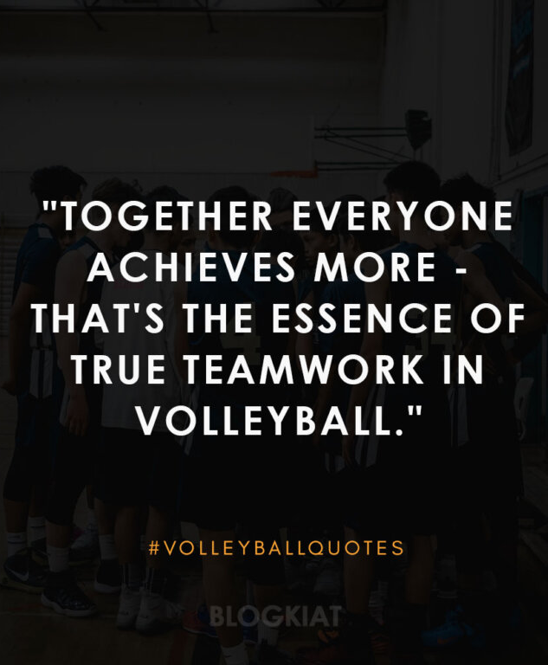
Coaching philosophy
Sportsmanship & team building vs. winning.
Work and compete hard.
Mistakes will happen.
We value and listen to the players’ opinions, suggestions and input.
Club coaches will be supportive of each other and act as resources and provide input to each other if needed.
Notes:
Our coaching philosophy places emphasis on the big picture versus winning at all costs. We want to work on sportsmanship, team building, helping players develop physically, psychologically and socially in the sport and have fun doing it. We encourage our players to work and compete hard. We want to build their confidence. Mistakes will happen when learning new things. We want them to challenge themselves without fear or punishment. We value and listen to the players. Our coaches are supportive of each other.

Slide 9

Code of Conduct
Building Relationships
Positive Attitude
Setting a Good Example
Notes:
One of the most important aspects of our club is to help all parents, coaches and players stay focused on the big picture. The complete Code of Conduct can be found on our web page and is also included in the registration form. The code of conduct expresses these core values, Demonstrating a Positive Attitude, Setting a Good Example and Maintaining Good Relationships between officials, opponents, players, parents and coaches.

Slide 10
Playing Time
Playing time is always a concern.
  Coaches are managing personal strengths, skill level, attitude, attendance, work ethic, positional needs, strategies, all while following the rules of the game.
      What is in the best interest of the team
  Every player will have some meaningful playing time through the season but may not play every match/set.
  11U/12U coaches will strive to provide equal playing time but will not necessarily sacrifice a win to do so
At no time will a coach discuss other player’s playing time with other parents, nor will playing time for their own child be discussed at a tournament
Notes:
Playing Time is always a concern when you sign your child up for a sport. Play time is a complex mix of an athlete’s personal strengths and limitations (physical, emotional, mental and social), skill level, attitude, attendance, work ethic, team’s positional needs. Ultimately, it comes down to “what is in the best interest of the team?” Every player will have some meaningful playing time through the season.
Our 11U/12U coaches will strive to provide equal playing time as much as possible but may not necessarily sacrifice a win to do so.
The difficult thing about playing time in volleyball, is that they can only play in one position, which goes by serving order. So if they start as player 1, get subbed out, they can only go back into that 1 position, they can’t go where player 5 was playing. So if you have a team of 7 or 8 players, two players will play about half the time on the court, where the other 5 will play the entire time.
Reiterate that playing time is not bought
Some parents and athletes will feel like they are entitled to playing time because they’ve paid the fees and scheduled weekly lessons, but a club team is still a team that has winning in mind. Some athletes will practice and play harder than others, and those are the ones that will be rewarded with playing time, and not simply because they’ve paid club fees. It’s important to communicate that playing time is earned, not bought.
At no time will a coach discuss other player’s playing time with other parents, nor will playing time for their own child be discussed at a tournament.

Slide 11
Club Policies
Please carefully and thoroughly read entire Policy Manual which can be found on the web site prior to registering
  https://deeagles.wixsite.com/jovolleyball/policies-by-laws
Policies to Note:
  Leaving Tournaments early:
    If you must leave early the day of a tournament, you must notify your coach in advance to help them plan accordingly, not the day of the tournament
  Player Injuries:
    Injured players that wish to return to play need to come to practices and watch before playing in a game.
    Serious injuries that required medical attention will require a clearance letter from a medical professional, MD, Athletic Trainer or Chiropractor
  Work Teams:
    If your team is the work team at the end of the tournament, everyone stays, plan accordingly.
Notes:
In regards to club policies, our policy manual is posted on our website. Please carefully and thoroughly read the entire policy manual before registering your child. We want to emphasize a policy that we’ve always had, and that’s about leaving tournaments early. If you have to leave early the day of a tournament, you must notify your coach in advance, preferably several days in advance, to help them plan accordingly.
For Injured players that wisth to return to plan, they need to come to practices and watch. They are also required to provide a clearance letter from a medical professional, MD, Athletic Trainer or chiropractor if they had a serious injury that required medical attations.
And finally, if your team loses and does not make it to the championship match, your team stays to officiate. Our new policy is that everyone stays, so plan accordingly.

Slide 12
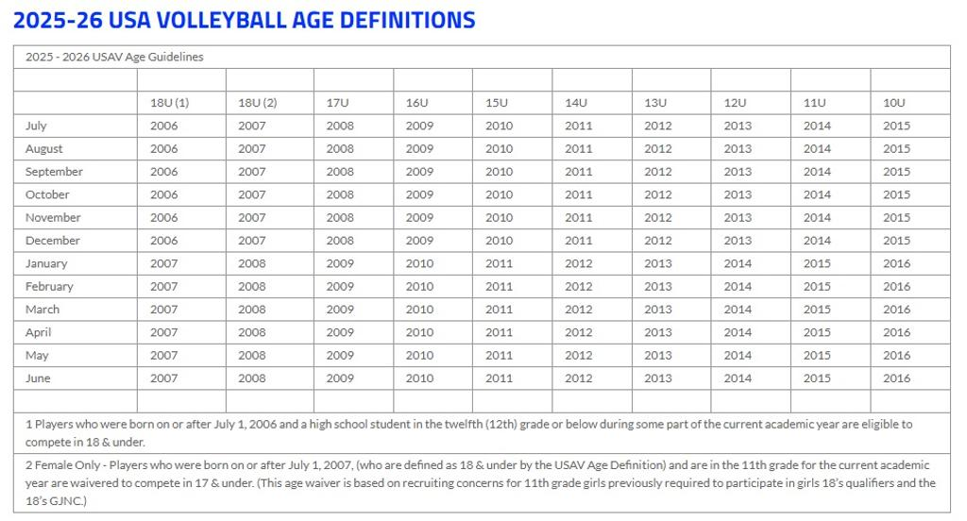
Notes:
This chart is hard to see, but I want you to be a little familiar with the age definition chart. To determine the correct age division for your child, first find their birthday month, then slide over to their birth year. You will need to select their age division when you register them. This chart will also be on the registration form when you sign up.

Slide 13
Program Specifics
For the most benefit and playing time we try to have teams of 10-12 players.
Teams are organized by: 10U, 11U, 12U, 13U, 14U, 15U, 16U, and 18U. Teams are determined by age, squad played in school or based on positional needs of the team. Final decisions are made by the coaches committee.
  Athlete Evaluations will be held on Sunday, November 16. More information to come. Athletes will be notified of team assignment approx. 1 week after.
    3:30-5:30 13U, 14U players
    6:00-8:00 15U, 16U, 17U, 18U players
Opportunities may arise where a player may be asked to play on a higher level on a substitutional basis.
Notes:
We will organize teams by age first, then take into consideration the squad they played on in school, and team positional needs. Team placement is decided by the coaches committee. We hold evaluations to help build cohesive teams not for cutting athletes from the program. Opportunities may arise where a player may be asked to play a high level team as a substitution.

Slide 14
Age Waiver
The JVA age waiver will allow the athlete to play at grade level with their peers, provided they are not more than one year older than the current age definition.
A copy of a certified birth certificate and proof of grade (copy of school schedule, school id, report card, etc.) showing the player's current school year and grade must be given to your child’s coach to show to the Tournament Director prior to team check-in.
Notes:
JVA allows age waivered players in club division competitions - the age waiver will allow the athlete to play at grade level with their peers, provided they are not more than one year older than the current age definition.
A copy of a certified birth certificate and proof of grade (copy of school schedule, school id, report card, etc.) showing the player's current school year and grade must be given to your child’s coach to show to the Tournament Director prior to team check-in.

Slide 15
Tentative schedules
Practices – Starting Sunday, Nov. 30th
Sundays
  14U Noon – 1:30 Elementary School
  11U 1:30 – 3:00 Elementary School
  12U 3:00 – 4:30 Elementary School
  10U 4:30 – 6:00 Elementary School
  13U 6:00 – 7:30 Elementary School
  15U, 16U, 17U, 18U Noon – 2:00 High School
Mondays*
  7:00-8:30 Elementary School
Wednesdays*
  7:00-8:30 NVC
Tournaments
A Preliminary Tournament schedule will be posted on our website by the end of the October.
Please notify Coach ASAP if a tournament date does not work.
If you play multiple sports, please give the schedule to the coaches of the other sport and request that they not schedule tournaments on the same dates as VB.
Notes:
Please let your coach know ahead of time if you cannot be at a practice, I cannot stress this enough. Missing a practice won’t affect playing time, but not letting your coach know will.

Slide 16
Attendance Policy
ATTENDANCE
  Attendance is expected at all practices and tournaments. Players will be allowed to miss up to two practices for the following approved reasons only. Approved absences are defined as illness, injury, or family event. More than two excused absences will result in reduced playing time as outlined in the DISCLIPLINARY ACTIONS section of the policy
ABSENCES
  An unexcused absence will be counted against the player for a no call or no show or for missing for other non-school sporting events that conflict with the club schedule.
    Ie. – non school = community education, AAU, etc.
DISCIPLINARY ACTIONS – Players lose playing time, but are expected to be present
    Level 1 Offense – Player will sit for first assigned match of the tournament
    Level 2 Offense – Player will sit for the first two assigned matches of the tournament
    Level 3 Offense – Probationary Period, player will not play in entire tournament
    Level 4 Offense – Expulsion – No Refund
    One UNEXCUSED absence or 3 EXCUSED absences = Level 1 Offense
    Two UNEXCUSED absences or 4 EXCUSED absences = Level 2 Offense
    Three UNEXCUSED absences = Level 3 Offense
    Four UNEXCUSED absences = Level 4 Offense

Slide 17

24-hour rule & Conflict Resolution
Emotions can be high during a competition. Please wait a minimum of 24 hours to contact the coach to set up a meeting to address and discuss issues.
The line of communication should be from coach to athlete to parent.
  Step 1: Athlete requests a meeting with the Coach.
  Step 2: Athlete and Parent requests a meeting with Coach & Director.
Notes:
If there are conflicts, we ask that the communication plan between coach/athlete/parent be followed. The line of communication is first the athlete requests to meet with their coach, then if needed, a meeting with coach, athlete, parent and director can be requested. Please be respectful of the 24-hour rule and wait a minimum of 24 hours to set up a meeting to address and discuss issues so that emotions have had a chance to simmer down and issues can be discussed rationally.

Slide 18
Program fees
10U = $175*
Dover-Eyota School District 11U – 18U = $250*
Non-Dover-Eyota School District 11U – 18U = $300*
Limited Hardship Scholarship money is available
$25 is non-refundable if you withdraw registration
Gym Rental
Tournament Entries
  JVA Insurance
Stipend for Coaches
Equipment
Advertising
Miscellaneous-Legal, Accounting, Office
Academic Scholarship
Notes:
Our Program fee covers gym rental, tournament entry fees, buys JVA insurance and pays the club director fee. It provides stipend for coaches. It also pays for equipment, advertising and miscellaneous expenses. We do have limited scholarship money available, and if the fee is a hardship and help is needed, please talk to me privately and I can give you that information.

Slide 19
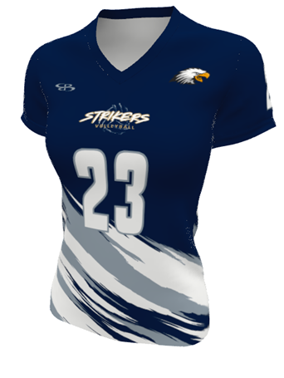
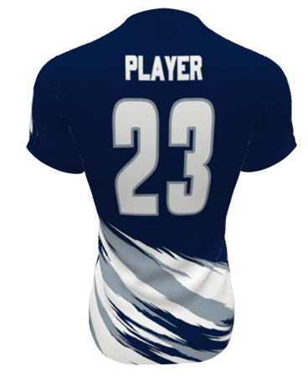
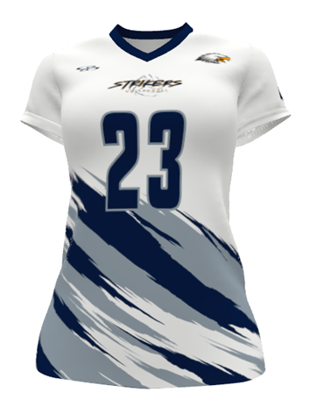
Uniforms
Players
Libero
All bottoms must match:
Black spandex or black shorts or leggings are required and provided by player.
Uniforms = $45 *Design is changed every 2 years *New design this year
Notes:
All players must have the same colored bottoms, black. They can be black spandex, black shorts or black leggings and are provided by the player. The jerseys are made by Boombah, are a moisture wicking material with sublimated printing so that the numbers/letters don’t wear off. I will be placing our order a few weeks after registration closes. The jerseys typically arrive in about three weeks.

Slide 20
Registration and Payment is Online!
REGISTRATION PERIOD:
September 28th through November 9th at noon
REQUIRED FORMS:
Player Club Registration & Code of Conduct Form
JVA Waiver, Emergency & Medical Contact Information
OPTIONAL FORMS:
Uniform Order Form if needing a new jersey
Waiver to Play Up
Notes:
Registration is Online. Each player is required to complete the Player club registration and code of conduct form, and the JVA Waiver, Emergency and Medical Contact Information form. Optional forms to be completed are the uniform order form and the waiver to play up for players that wish to play at a higher level.

Slide 21
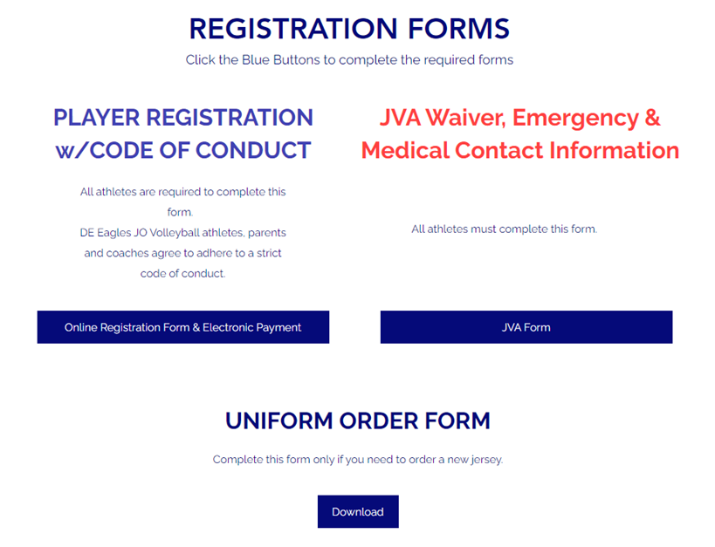
Online Registration
Notes:
To access the Online Registration forms, you will go to our club web site at this link. This is a screen shot of the web page. Click on the blue download button for the PowerPoint presentation for this meeting, then go to the bottom of the registration page and click on the registration forms button.

Slide 22
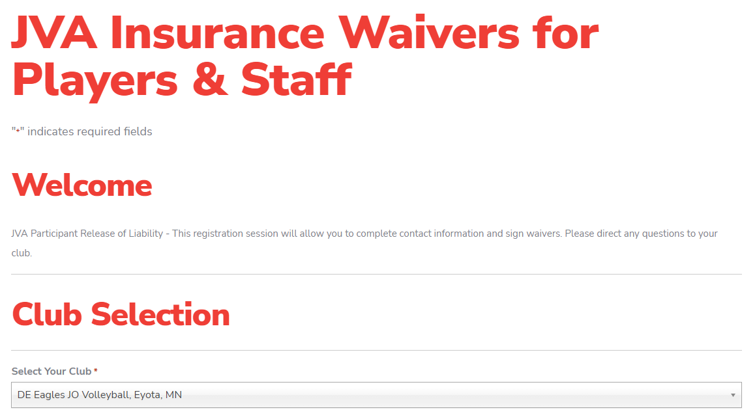
JVA Waiver, Emergency & Medical Contact Information Forms
Notes:
This is what the JVA screen will look like when your first get there to complete the JVA waiver and emergency contact information. You can see under Club Selection, you will find our club listed like this.

Slide 23
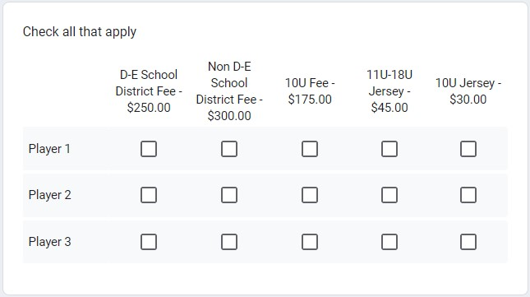
Electronic Payment
An electronic payment section has been added to the registration form: after you complete the form and hit submit, you will be taken to a PayPal link in which you can use your credit card, or a PayPal account
Notes:
An electronic payment section has been added to the registration form: after you complete the form and hit submit, you will be taken to a PayPal link in which you can use your credit card, or a PayPal or Venmo account

Slide 24
Payment
Registration and full payment is due by Sunday, November 9
  Absolutely no late registrations will be accepted after November 9!
$25 Late fee for payment after November 9
No participation allowed until full payment and forms are turned in to the Director
Notes:
Registration and Full payment are due by Sunday November 9. There will be absolutely no late registrations accepted after November 9th. $25 late fee for late payments.

Slide 25
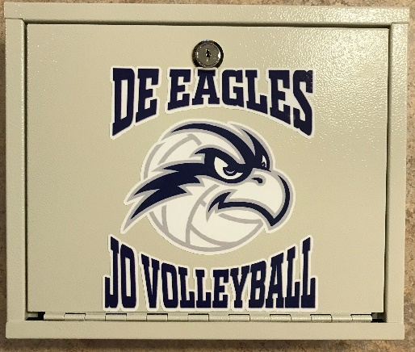
Form Drop Off Options
Use Drop Box at Bennett’s Eyota
Market in Sliding Door
Entry Vestibule………..
Mail to:
DE Eagles JO Volleyball
917 Jefferson Ave SW, Eyota, MN 55934
Email PDF files of completed Jersey or Optional forms to deeaglesjovolleyball@gmail.com

Slide 26


Club Swag
Purchase directly through web page from Shea Design
https://dejovolleyball2024.itemorder.com/
Order deadline – November 16, 2025

Slide 27
February Eagle Leap Tournament
This is a yearly event that serves as the primary fundraiser for our club.
Players that volunteer at the event receive a $50 credit on their next year’s registration fee.
Club Director will email players who have a $50 credit for this year that worked last year.
Notes:
Each year, we have a tournament for our 16U team which we host locally at the high school. This year’s tournament will be February 25. This tournament is a way for our club to earn funds and helps reduce the player’s registration fees. Players that volunteer at this event receive a $50 credit on their next year’s registration fee. I have already emailed the players that have a $50 credit to use for this year.

Slide 28
Academic Scholarship Program
DE Eagles JO Volleyball will award up to $1,000 in scholarships to graduating senior/s who complete the application process
Purpose: To support and encourage DE Eagles JO Volleyball athletes who choose to pursue a higher education and to recognize the student-athlete who demonstrates character traits such as leadership, sportsmanship, accountability, integrity, a strong work ethic, responsibility, and perseverance.
Please see or email club director for an application
Applications are due by March 21, 2026
Notes:
We are happy to announce that we will be awarding up to $1000 in scholarships to graduating seniors who complete the application process. For example, if we have two applicants, we may give two $500 awards. 4 applications could each receive $250. The purpose of the scholarship is to support and encourage DE Eagles JO Volleyball athletes who choose to pursue a higher education and to recognize the student-athlete who demonstrates character traits such as leadership, sportsmanship, accountability, integrity, a strong work ethic, responsibility, and perseverance.

Slide 29

Please consider volunteering to help supervise practices
Background screening and Abuse Prevention System Training (APS) is required
Screening and Training paid by club
Notes:
Again, we are asking for volunteers to be present at practice to fulfill our new club policy of two adults at every practice. Please consider volunteering to help supervise. You will be required to complete a background screen and the Abuse Prevention System Training through JVA. You’ll be reimbursed by the club the $38 cost to be screened. Contact me if you can volunteer!

Slide 30


@de.eagles.jo.volleyball
Website: https://deeagles.wixsite.com/jovolleyball
Email: deeaglesjovolleyball@gmail.com
Notes:
There are several ways to stay connected with our club and be in the know, including Facebook, and our website, which is the best place to get the most up to date information. Email will be the primary source of communication for sending out tournament schedules, cancellations for weather, etc. Feel free to call or text me with questions.

